Slide 1
ELECTRICAL SCIENCE-2 (15B11EC211) UNIT-5 Lecture-3

Slide 2
Topics to be Discussed
Rectifier Circuits
Half Wave Rectifier
Parameters of the Half Wave Rectifier
Efficiency of Half Wave Rectifier
Ripple Factor
Peak Inverse Voltage
Peak Factor
Form Factor
Effect of Using a Silicon diode with V_{T} = 0.7V
Examples
References

Slide 3
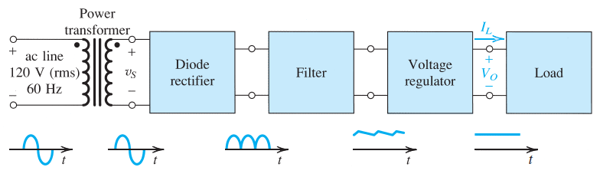
Rectifier Circuits [1, 2]
A rectifier is a circuit which converts the alternating current (AC) input power into a direct current (DC) output power.
One of the most important applications of diodes is in the design of rectifier circuits.
A diode rectifier forms an essential building block of the dc power supplies required to power electronic equipment.
A block diagram of such a power supply is shown below.

Slide 4
Rectifier Circuits [1, 2]
The diode rectifier converts the input sinusoid to a unipolar output, which can have the pulsating waveform indicated in Figure.
Although this waveform has a nonzero average or a dc component, its pulsating nature makes it unsuitable as a dc source for electronic circuits, hence the need for a filter.
The variations in the magnitude of the rectifier output are considerably reduced by the filter block as given in Figure.
The output of the rectifier filter, though much more constant than without the filter, still contains a time-dependent component, known as ripple.
To reduce the ripple and to stabilize the magnitude of the dc output voltage of the supply against variations caused by changes in load current, a voltage regulator is employed.
Such a regulator can be implemented using the zener shunt regulator configuration.
Two Types of rectifications are possible.
Half Wave Rectifier
Full Wave Rectifier

Slide 5
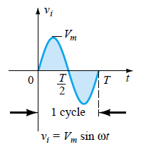
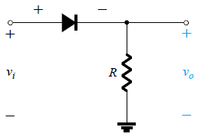
Half Wave Rectifier [1, 2]
The input power supply may be either a single-phase or a multi-phase supply with the simplest of all the rectifier circuits being that of the Half Wave Rectifier.
The process of removing one half of the input signal to establish a dc level is called half wave rectification.
The primary of the transformer is connected to ac supply. This induces an ac voltage across the secondary of the transformer.
In Half wave rectification, the rectifier conducts current during positive half cycle of input ac signal only. Negative half cycle is suppressed.

Slide 6
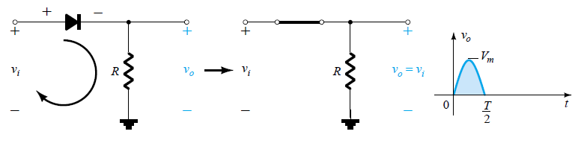
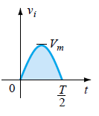
Half Wave Rectifier [1, 2]
Operation:
Case 1: During “positive” half cycle (0 to T/2) of the AC sine wave, the diode is forward biased as the anode is positive with respect to the cathode resulting in current flowing through the diode.
Since the DC load is resistive (R), the current flowing in the load resistor is therefore proportional to the voltage across the load resistor, v_{o} = v_{i}.

Slide 7
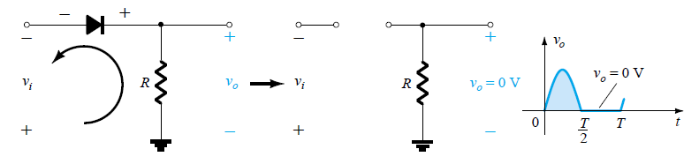
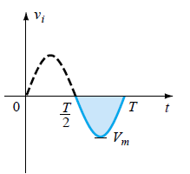
Half Wave Rectifier [1, 2]
Case 2: During “negative” half cycle (T/2 to T) of the AC sinusoidal input waveform, the diode is reverse biased as the anode is negative with respect to the cathode. Therefore, NO current flows through the diode or circuit.
Then in the negative half cycle of the supply, no current flows in the load resistor as no voltage appears across it so therefore, v_{o} = 0.

Slide 8
Parameters of the Half Wave Rectifier [2]
Let v_{i} = V_{m} sinωt be the input voltage to the rectifier, where V_{m} is the peak input voltage.
Let r_{f} is the resistance in the forward direction i.e. in the ‘ON’ state, and R_{R} (= ∞) in the reverse direction i.e. in the ‘OFF’ state.
where,

Slide 9
DC output current or Average Current (I_{dc}):
If R_{L}>>r_{f}, then
DC output voltage or Average Voltage (V_{dc}):
If R_{L}>>r_{f}, then

Slide 10
RMS Current (I_{rms}):
RMS Voltage (V_{rms}):
If R_{L}>>r_{f}, then

Slide 11
Efficiency of Half Wave Rectifier [2]
The ratio of DC output power to the applied input AC power is known as rectifier efficiency.
The efficiency of a half wave rectifier is equal to 40.6% (i.e. η_{max} = 40.6%).

Slide 12
Ripple Factor [2]
Ripple Factor is the ratio of rms value of ac component present in the rectified output to the average value/dc value of rectified output. It is a dimensionless quantity and denoted by ‘r’.
Ripple factor of Half wave rectifier:

Slide 13
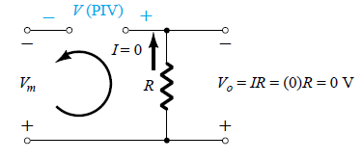
Peak Inverse Voltage [1, 2]
Peak inverse voltage (PIV) or peak reverse voltage (PRV) is the maximum voltage that the diode can withstand without breakdown during reverse bias condition.
If a voltage is applied more than the PIV, the diode will be burned or damaged.
The required PIV rating for the half-wave rectifier can be determined as shown below
Applying Kirchhoff”s voltage law, it is fairly obvious that the PIV rating of the diode must equal or exceed the peak value of the applied voltage.

Slide 14
Peak Factor [2]
Peak Factor is defined as the ratio of maximum/peak value to the RMS value of an alternating quantity. The alternating quantities can be voltage or current.
For the half wave rectifier :

Slide 15
Form Factor [2]
The ratio of the RMS value to the average value of an alternating quantity (current or voltage) is called Form Factor.
For the half wave rectifier :

Slide 16
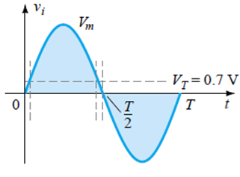
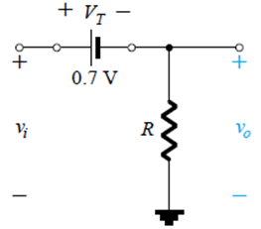
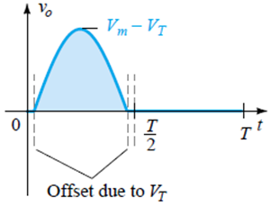
Effect of Using a Silicon Diode with V_{T} = 0.7V [1]
For the forward-bias region in the HWR:
The applied signal must now be at least 0.7V before the diode can turn ‘ON’.
For levels of v_{i} less than 0.7V, the diode is still in an open circuit state and v_{o} = 0V as shown in the same figure.
When conducting, the difference between v_{o} and v_{i} is a fixed level of V_{T} = 0.7V and v_{o} = v_{i} -V_{T}.

Slide 17
Properties | Half Wave Rectifier
 | Ideal diode | Diode with V_{T}
D.C. Current (I_{dc}) | I_{m}/π | I_{m}/π
Maximum Current (I_{m}) | V_{m}/(r_{f}+R_{L}) | (V_{m}-V_{T})/(r_{f}+R_{L})
D. C. voltage (V_{dc}) | 0.318V_{m} | 0.318(V_{m}-V_{T})
Maximum efficiency | 0.406/(1+(r_{f}/R_{L})) | 0.406/(1+(r_{f}/R_{L}))
Peak Inverse Voltage | V_{m} | V_{m}

Slide 18
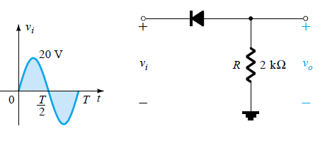
Example [1]
(a) Sketch the output v_{o} and determine the dc level of the output for the network of given figure.
(b) Repeat part (a) if the ideal diode is replaced by a silicon diode.

Slide 19
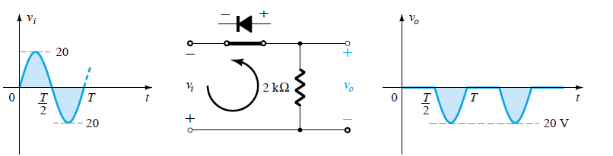
Solution:
(a) In this situation the diode will conduct during the negative part of the input as
shown in Fig., and v_{o} will appear as shown in the figure.
For the full period, the dc level is
The negative sign indicates that the polarity of the output is opposite to the defined
polarity.

Slide 20
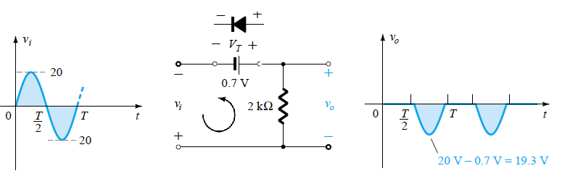
(b) Using a silicon diode, the circuit and the output v_{o} will appear as shown in the figure below.

Slide 21
Example [2]
A diode having internal resistance r_{f} = 20Ω is used for half-wave rectification. If the applied voltage v = 50sinωt and load resistance R_{L}= 800 Ω, find: (i) I_{m}, I_{dc}, I_{rms} (ii) AC power input and DC power output (iii) DC output voltage (iv) Efficiency of rectification.
Solution: v = 50sinωt
Maximum voltage, V_{m} = 50V
(i)

Slide 22
(ii) AC power input (P_{ac})
DC power output (P_{dc})
(iii) DC output voltage (V_{dc})
(iv) Efficiency of rectification

Slide 23
Example [2]
A half-wave rectifier is used to supply 50V DC to a resistive load of 800 Ω. The diode has a resistance of 25 Ω. Calculate AC voltage required.
Solution: Output DC voltage, V_{dc} = 50V
Diode resistance, r_{f} = 25 Ω
Load resistance, R_{L}= 800Ω
Let V_{m} be the maximum value of AC voltage required

Slide 24
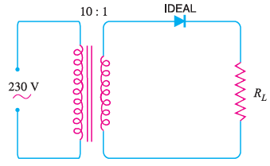
Example [2]
An AC supply of 230 V is applied to a half-wave rectifier circuit through a transformer of turn ratio 10 : 1. Find (i) the output DC voltage and (ii) the peak inverse voltage. Assume the diode to be ideal.

Slide 25
Solution: RMS primary voltage = 230V
Maximum primary voltage (V_{pm})
output DC voltage (V_{dc}):
Peak inverse voltage: During the negative half-cycle of a.c. supply, the diode is reverse biased and hence conducts no current. Therefore, the maximum secondary voltage appears across the diode.

Slide 26
References
[1] R. Boylestad and L. Nashelsky, ‘Electronic Devices and Circuit Theory’, PHI, 7e, 2001.
[2] D.C. Kulshreshtha, ‘Electronic Devices and Circuits’, New Age, 2e, 2006.

